Slide 1

MINOR PROJECT - II ON ART BLOCK (MCA – II SEMESTER; BATCH 2022-24)
Internal Guide
Dr. Sunil Pratap Singh (Assoc. Prof. BVICAM, New Delhi)
Presentation by
Vaibhav Aggarwal(35411604422)
Nishika Kumar(02511604422)
Urvashi Rajpal(35111604422)
Notes:
1

Slide 2
Contents
Problem Description
Aim and Objectives
Methodology and Technology Used for Project Development
Modules
Design Documents (Use Case, Data Flow Diagram, Entity-Relation Diagram, etc.)
Screenshots
Conclusion and Future Scope
References

Slide 3
Problem Description
While NFTs have gained significant attention and adoption within certain communities, achieving widespread mainstream acceptance and understanding remains a challenge. The complex nature of blockchain technology and the perception of NFTs as primarily speculative assets can deter potential users and investors.
The ease of copying and reproducing digital content poses a challenge for the protection of intellectual property rights within the NFT space. Copyright infringement and plagiarism can diminish the value and trust associated with NFTs.
As interest in NFTs grows, scalability becomes a challenge for existing blockchain networks. Congestion and high transaction fees can limit the accessibility and usability of NFT platforms, discouraging smaller creators and collectors from participating.
The world of non-fungible tokens (NFTs) has seen the rise of several popular and influential collections. Among these, CryptoPunks stands as one of the earliest and most iconic NFT projects, featuring 10,000 unique pixel art characters that hold historical significance within the NFT space.

Slide 4
Aim and Objectives
Aim:
The aim for developing an NFT project is to leverage blockchain technology to tokenize and represent unique assets, creating a secure and transparent system for buying, selling, and trading digital assets.
Objectives:
Tokenize a wide range of unique assets, such as artwork, collectibles, virtual real estate, music, and more.
Establish a tamper-proof record of ownership and transaction history, ensuring authenticity and provenance.
Enable creators to earn ongoing royalties or revenue from the resale or licensing of their digital assets.
Democratize access to digital assets and opportunities by creating a decentralized marketplace

Slide 5
Methodology and Technology Used
Methodology used for Project Development:
Agile Model
Technology used for Project Development:
Front-End: HTML v5.0, TailwindCSS v3.3.2, ReactJs v18.2.0
Back-End: NPM v6.14.18, MetaMask v10.31.1
Integrated Development Environment (IDE): VS Code
Database: ThirdWeb v1.9.2

Slide 6

Project Modules
Connect Wallet
User can connect his/her MetaMask wallet with the website
Listing NFT
Connected user can see all the active NFT listed in ThirdWeb
Purchasing NFT
Connected user can purchase a NFT which he/she selected.
Dashboard
Connected user can see all the NFT he/she purchased/owned

Slide 7
System Design

Slide 8
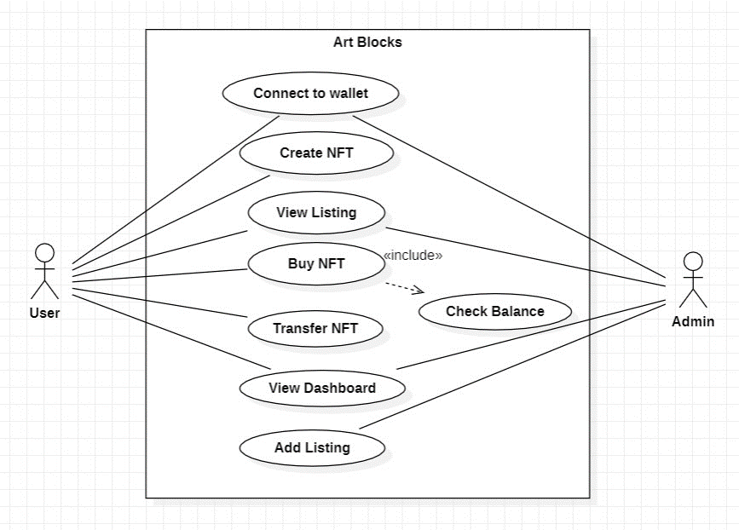
Use Case Diagram

Slide 9
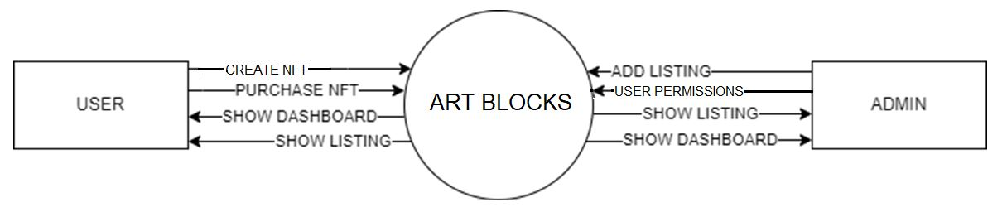
DFD Level-0

Slide 10
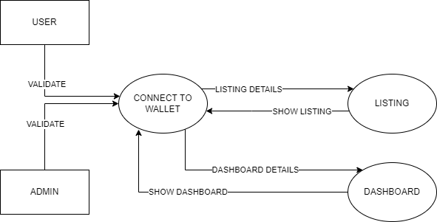
DFD Level-1

Slide 11
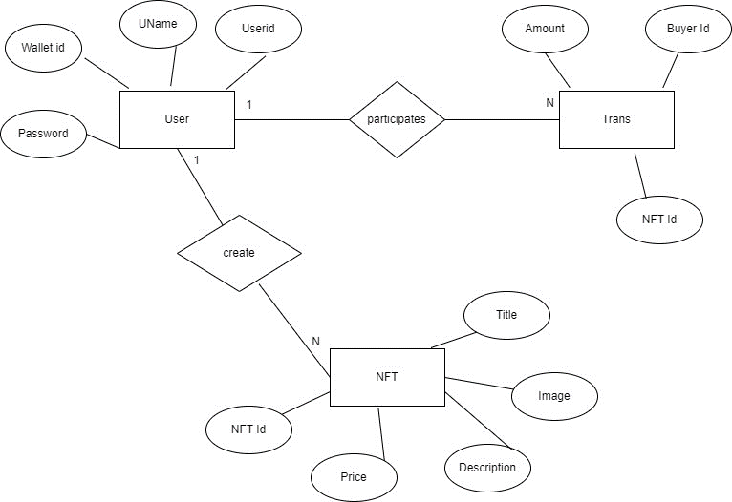
ER Diagram

Slide 12
Screenshots

Slide 13
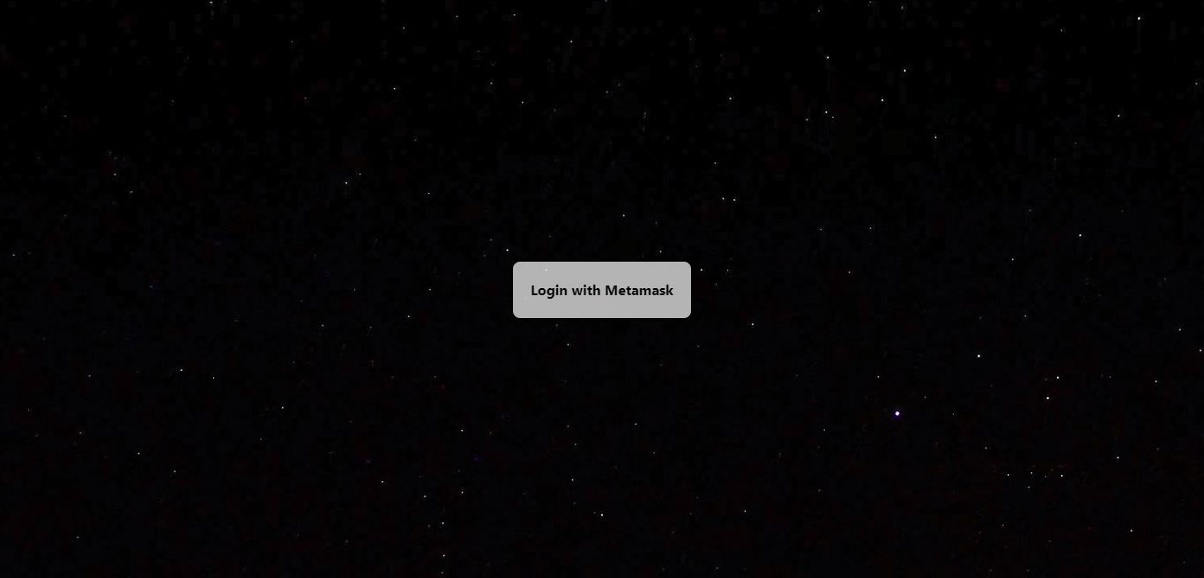
Screenshot - 1: Connect

Slide 14
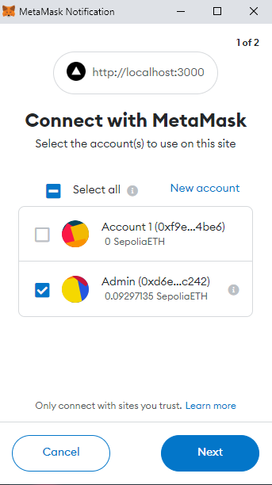
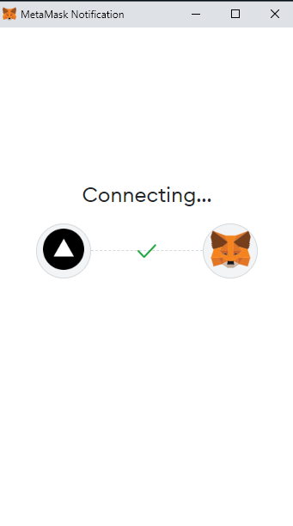
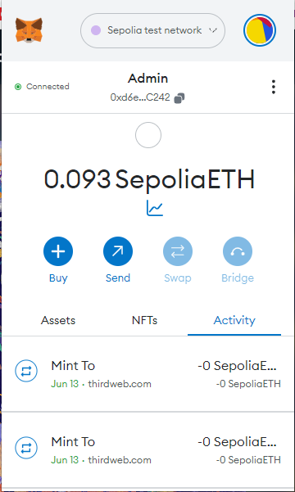
Screenshot – 2: Wallet

Slide 15
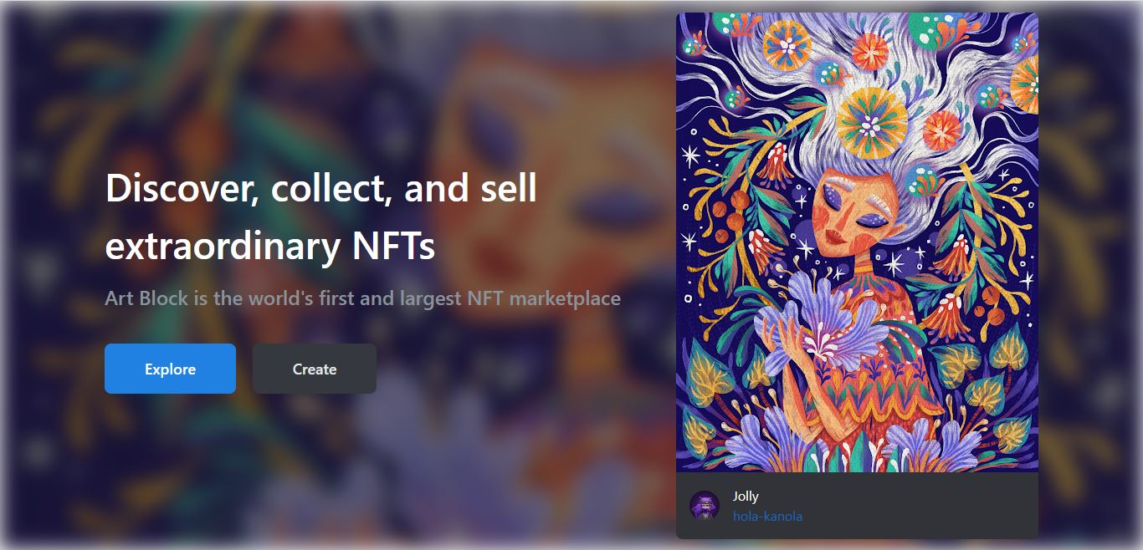
Screenshot - 3: Home

Slide 16
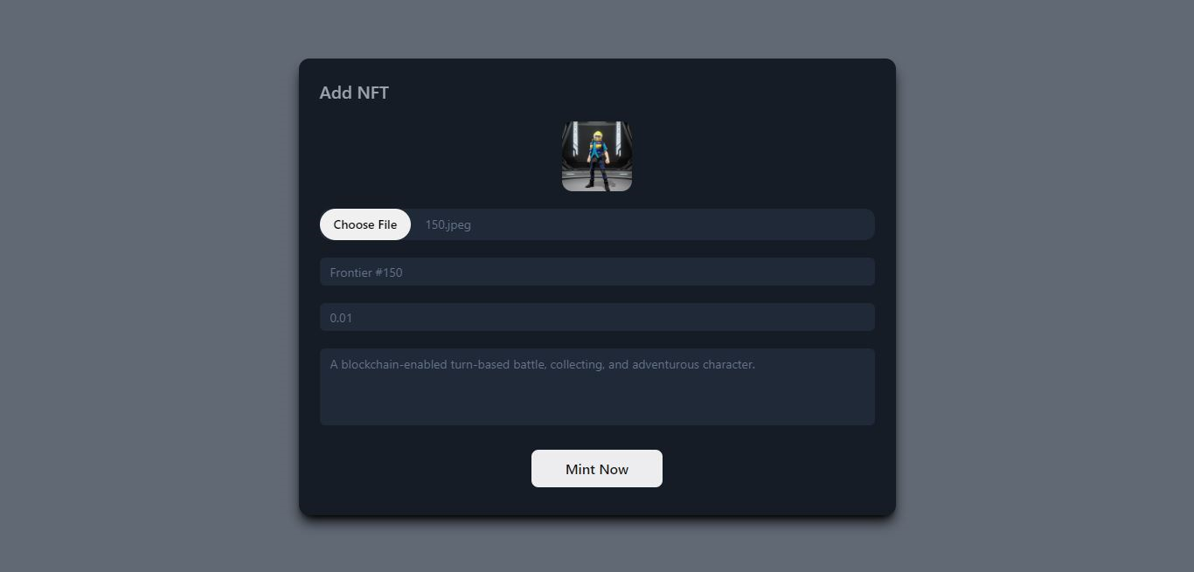
Screenshot-4: Create NFT

Slide 17
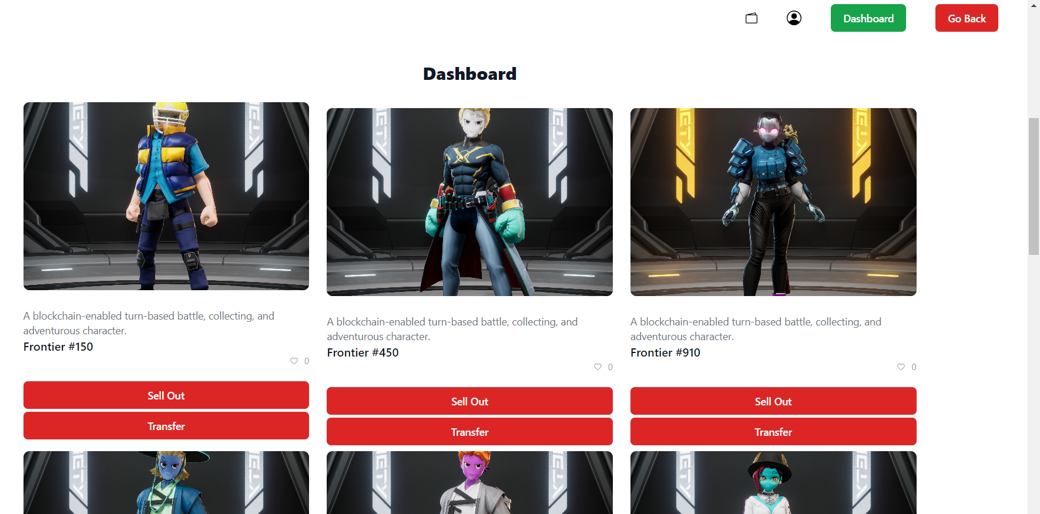
Screenshot-5: Dashboard

Slide 18
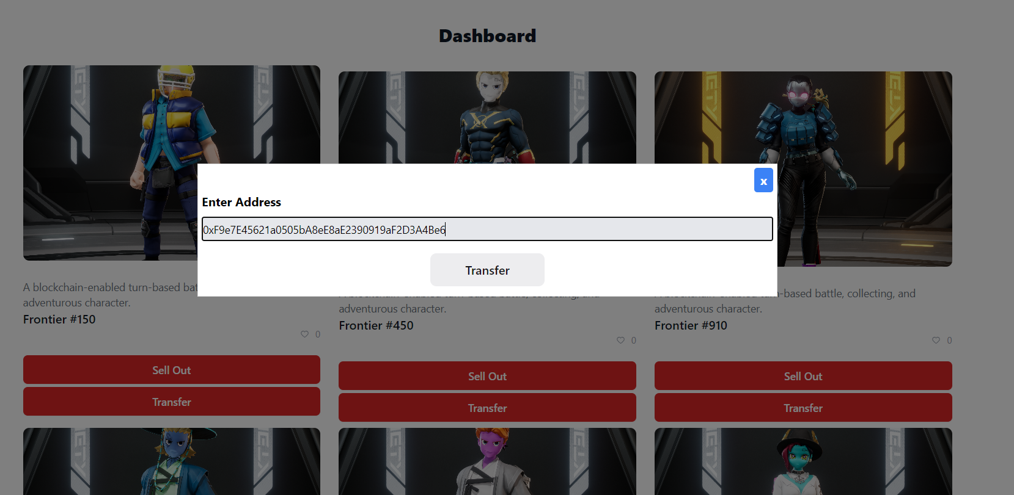
Screenshot-6: Transfer NFT

Slide 19
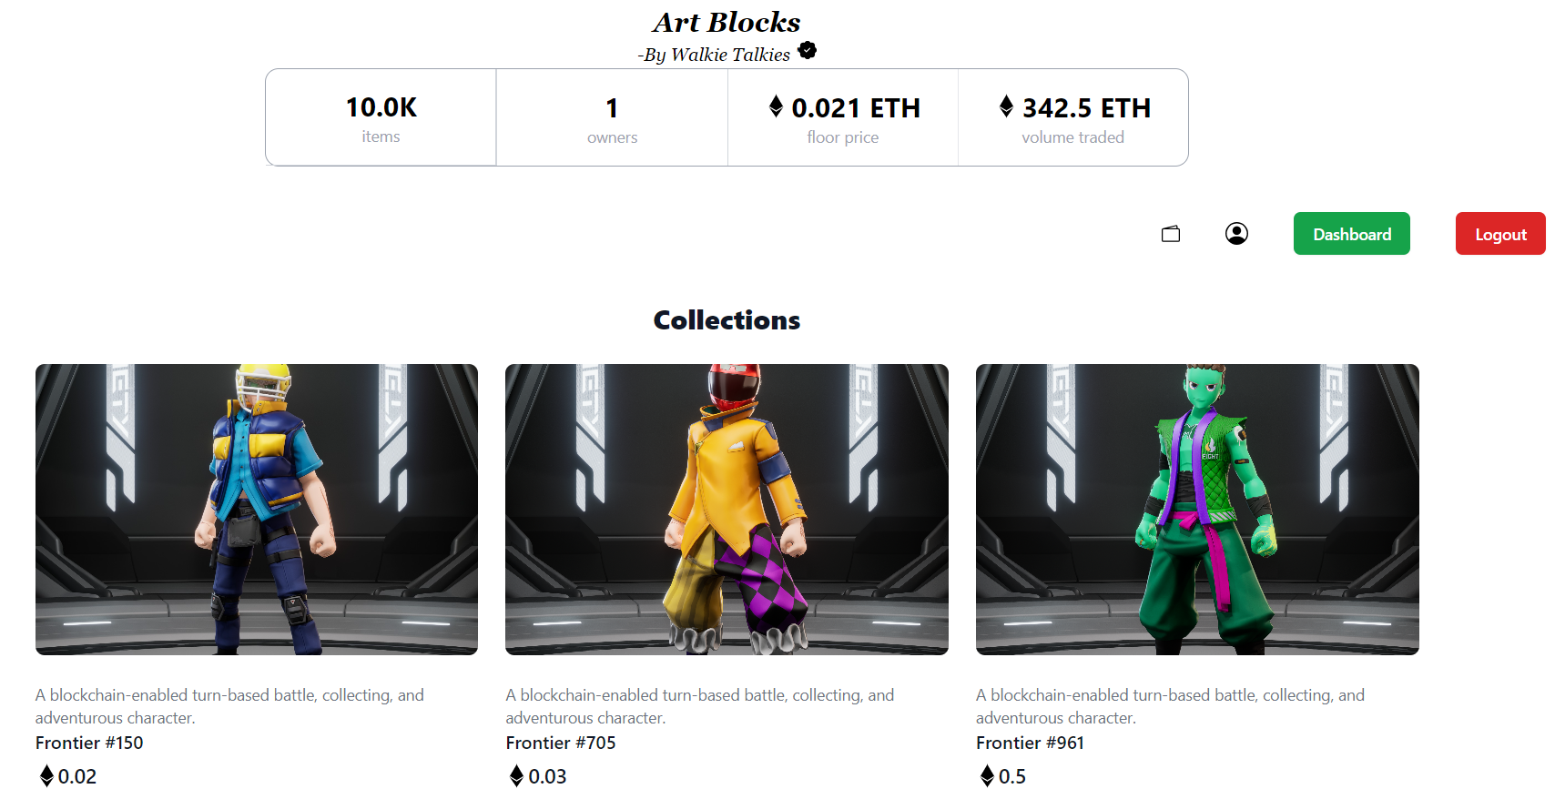
Screenshot-7: Collections

Slide 20
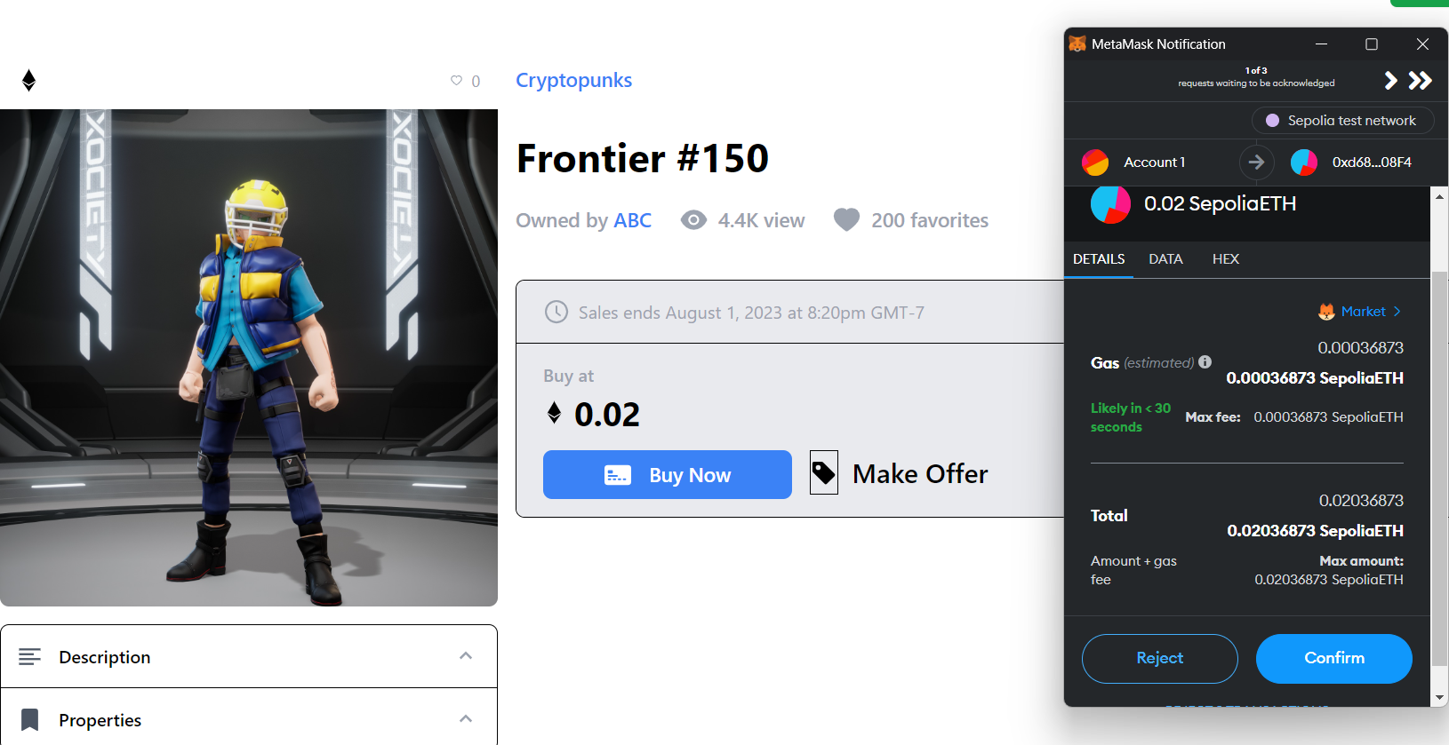
Screenshot-8: Buy NFT

Slide 21
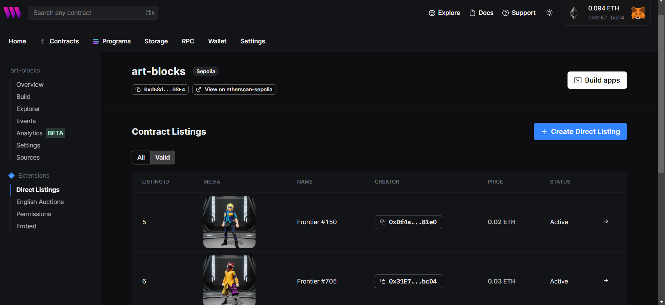
Screenshot-9: MarketPlace

Slide 22
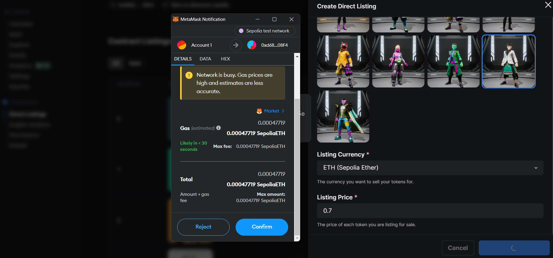
Screenshot-10: Add Listing

Slide 23
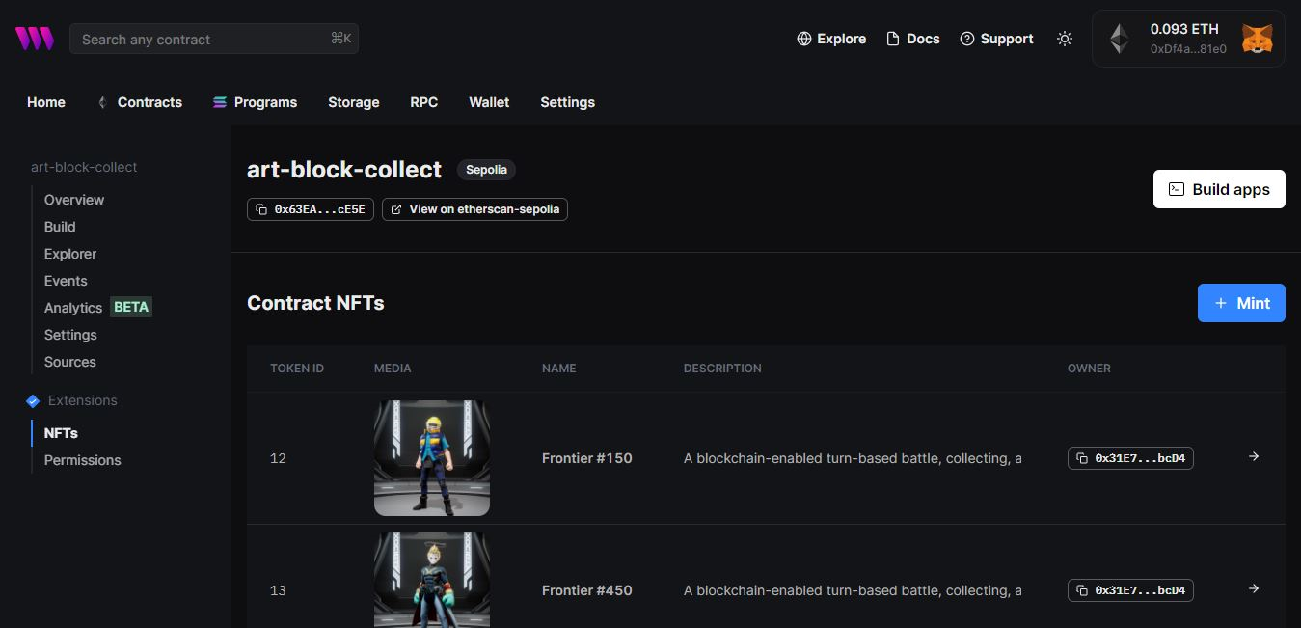
Screenshot-11: ThirdWeb Collection

Slide 24
Conclusion
In conclusion, our NFT marketplace project, leveraging Metamask and the principles of the Third Web, aims to create an innovative and user-centric platform for trading non-fungible tokens (NFTs). By combining the secure and decentralized nature of Metamask with the vision of the Third Web, we are poised to revolutionize the way users interact with digital assets.
Our marketplace offers a seamless integration with Metamask, allowing users to connect their wallets securely and participate in NFT transactions with ease. The use of blockchain technology ensures transparent and tamper-proof transactions, empowering users with true ownership and control over their digital assets.

Slide 25
Future Scope
Indeed, the world is changing fast. It is moving away from old- conventional ways of transaction to digitally advanced wallets that make space for both money and crypto currencies. With so many raging possibilities, it’s important to understand the differences between the various types of currencies. Digital currency is government- issued electronic form of money.
Community and Social Features
We can further foster community engagement within our NFT project by enhancing social features, facilitating user collaborations, and hosting virtual events or auctions.
This would create a thriving community of artists, collectors, and enthusiasts, enhancing the overall user experience.

Slide 26
References
https://thirdweb.com/dashboard
https://www.sanity.io/docs/schema-types
https://faucets.chain.link/goerli
https://metamask.io/
https://nextjs.org/
https://reactjs.org/docs/getting-started.html
React In Action by: Mark Tielens Thomas
Road to learn React: Robin Wipruch

Slide 27
